Slide 1

Networks & Security Lecture-1
www.corvit.com

Slide 2
Topics
What is a Network?
Types of Network
Network Topologies
Peer-to-Peer vs Client Server Architecture
Physical Media
What is Internet?
What is a Protocol?
OSI Model
OSI vs TCP/IP
Network Protocols Port Numbers
Network Security
Firewall
www.corvit.com

Slide 3




















What is the Network?
Communication between different computing devices over a shared medium to exchange data is known as a Network.
mobile network
PC
billions of connected computing devices:
hosts = end systems
running network apps
global ISP
server
wireless
laptop
home
network
smartphone
communication links
fiber, copper, radio, satellite
transmission rate: bandwidth
regional ISP
wireless
links
wired
links
packet switches: forward packets (chunks of data)
routers and switches
router
institutional
network
www.corvit.com
Notes:
<number>

Slide 4
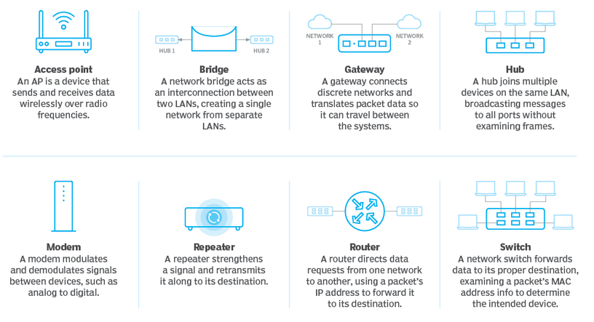
Network Devices
www.corvit.com

Slide 5
Types of Network
PAN (Example: Bluetooth)
LAN (Example: Networking in home, office)
WAN (Example: Internet )
WLAN (Example: Wi-Fi)
CAN (Example: University Network )
MAN (Example: Networking between banks in a city.)
SAN (Example: ERP and CRM Environments)
POLAN (Example: Can be used in Home, Offices, Universities, Hotels etc)
EPN (Example: IT Companies Network)
VPN (Example: Telecommuters)
www.corvit.com
Notes:
https://www.belden.com/blogs/smart-building/network-types

Slide 6

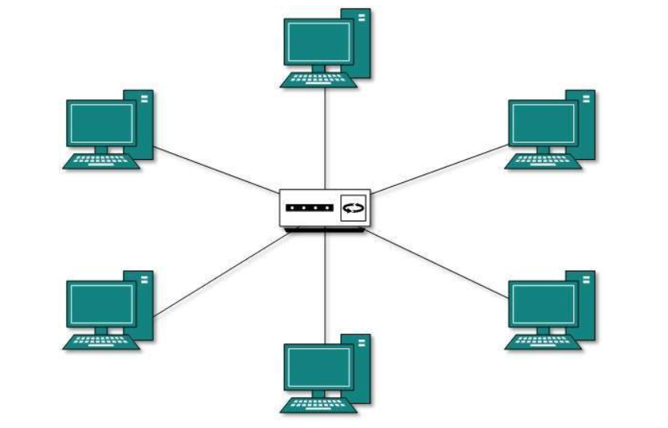
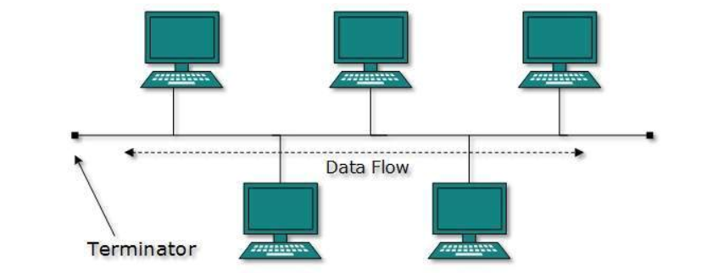
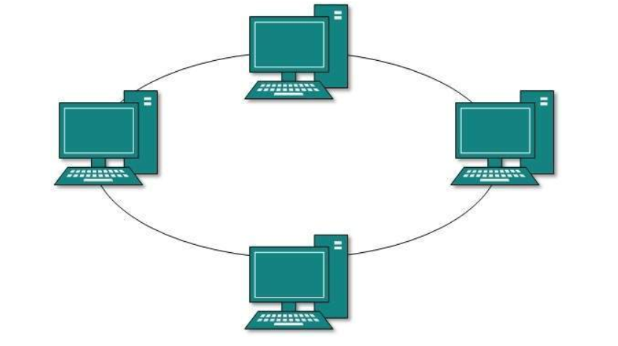
Network Topologies
Point-to-Point
Bus
Star
Ring
www.corvit.com
Notes:
https://www.tutorialspoint.com/data_communication_computer_network/computer_network_topologies.htm

Slide 7
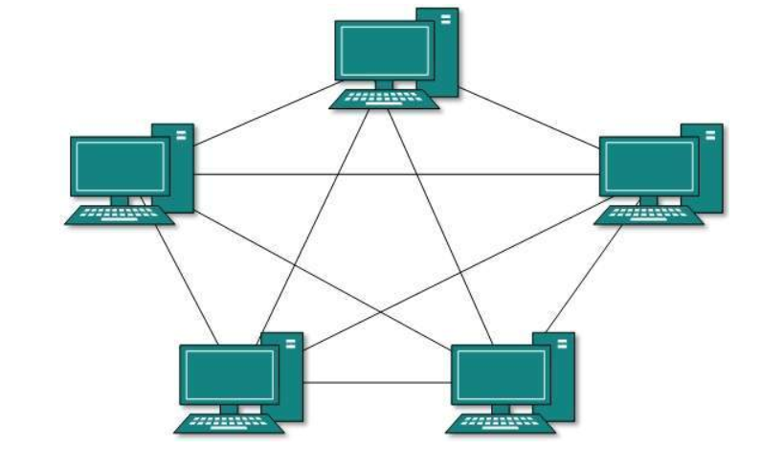

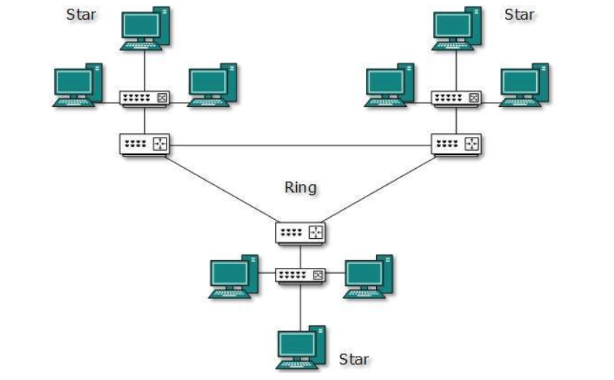
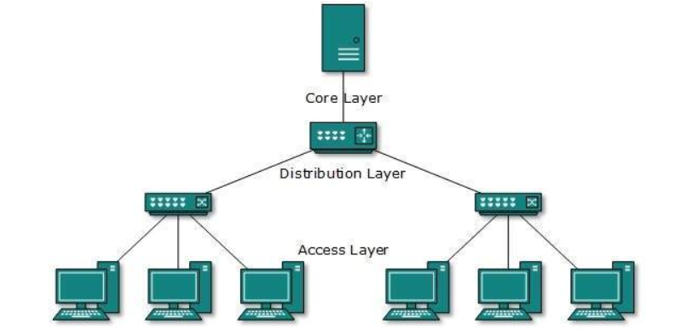
Network Topologies
Mesh
Tree
Daisy Chain
Hybrid
www.corvit.com

Slide 8
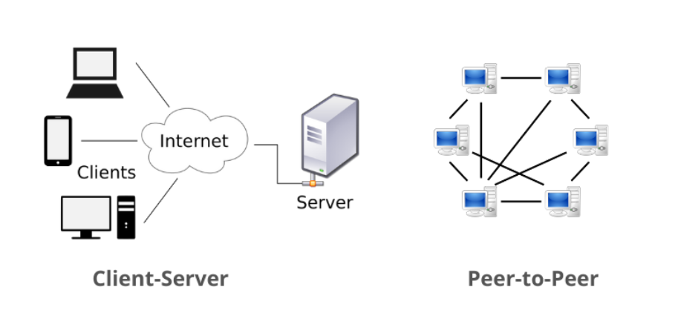
Peer-to-Peer vs Client Server Architecture
www.corvit.com

Slide 9
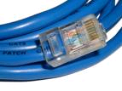
Physical media
bit: propagates between transmitter/receiver pairs
physical link: what lies between transmitter & receiver
guided media:
signals propagate in solid media: copper, fiber, coax
unguided media:
signals propagate freely, e.g., radio
twisted pair (TP)
two insulated copper wires
Category 5: 100 Mbps, 1 Gbps Ethernet
Category 6: 10Gbps
www.corvit.com

Slide 10


Physical Media: Coax, Fiber
coaxial cable:
two concentric copper conductors
bidirectional
broadband:
multiple channels on cable
HFC
fiber optic cable:
glass fiber carrying light pulses, each pulse a bit
high-speed operation:
high-speed point-to-point transmission (e.g., 10’s-100’s Gbps transmission rate)
low error rate:
repeaters spaced far apart
immune to electromagnetic noise
www.corvit.com

Slide 11
Physical Media: Radio
signal carried in electromagnetic spectrum
no physical “wire”
bidirectional
propagation environment effects:
reflection
obstruction by objects
interference
radio link types:
terrestrial microwave
e.g. up to 45 Mbps channels
LAN (e.g., WiFi)
54 Mbps
wide-area (e.g., cellular)
4G cellular: ~ 10 Mbps
satellite
Kbps to 45Mbps channel (or multiple smaller channels)
270 msec end-end delay
geosynchronous versus low altitude
www.corvit.com

Slide 12
What is the Internet?
Internet: “network of networks”
Interconnected ISPs
protocols control sending, receiving of messages
e.g., TCP, IP, HTTP, Skype, 802.11
Internet standards
RFC: Request for comments
IETF: Internet Engineering Task Force
mobile network
global ISP
home
network
regional ISP
institutional
network
www.corvit.com

Slide 13
Internet structure: network of networks
End systems connect to Internet via access ISPs (Internet Service Providers)
residential, company and university ISPs
Access ISPs in turn must be interconnected.
so that any two hosts can send packets to each other
Resulting network of networks is very complex
evolution was driven by economics and national policies
Let’s take a stepwise approach to describe current Internet structure
www.corvit.com

Slide 14
Internet structure: network of networks
Question: given millions of access ISPs, how to connect them together?
…
…
access
net
access
net
access
net
access
net
access
net
access
net
access
net
…
…
access
net
access
net
access
net
access
net
access
net
access
net
…
access
net
access
net
…
access
net
www.corvit.com

Slide 15
Internet structure: network of networks
Option: connect each access ISP to every other access ISP?
…
…
access
net
access
net
access
net
access
net
access
net
…
…
access
net
access
net
…
connecting each access ISP to each other directly doesn’t scale: O(N²) connections.
…
…
access
net
access
net
…
access
net
access
net
access
net
…
access
net
…
access
net
access
net
…
access
net
www.corvit.com

Slide 16
Internet structure: network of networks
Option: connect each access ISP to one global transit ISP?
Customer and provider ISPs have economic agreement.
…
access
net
…
access
net
access
net
access
net
access
net
access
net
access
net
global ISP
…
…
access
net
access
net
access
net
access
net
access
net
…
access
net
access
net
access
net
…
access
net
www.corvit.com

Slide 17
Internet structure: network of networks
But if one global ISP is viable business, there will be competitors ….
…
…
access
net
access
net
access
net
access
net
access
net
access
net
ISP A
access
net
…
…
access
net
ISP B
access
net
ISP C
access
net
access
net
access
net
access
net
…
access
net
access
net
…
access
net
www.corvit.com

Slide 18
Internet structure: network of networks
But if one global ISP is viable business, there will be competitors …. which must be interconnected
Internet exchange point
…
…
access
net
access
net
access
net
access
net
access
net
IXP
access
net
access
net
ISP A
…
…
access
net
IXP
ISP B
access
net
ISP C
access
net
access
net
peering link
access
net
access
net
…
access
net
access
net
…
access
net
www.corvit.com

Slide 19
Internet structure: network of networks
… and regional networks may arise to connect access nets to ISPs
…
…
access
net
access
net
access
net
access
net
access
net
IXP
access
net
access
net
ISP A
…
…
access
net
IXP
ISP B
access
net
ISP C
access
net
access
net
access
net
regional net
access
net
…
access
net
access
net
…
access
net
www.corvit.com

Slide 20
Internet structure: network of networks
… and content provider networks (e.g., Google, Microsoft, Akamai) may run their own network, to bring services, content close to end users
…
…
access
net
access
net
access
net
access
net
access
net
IXP
access
net
access
net
ISP A
…
…
Content provider network
access
net
IXP
ISP B
access
net
ISP C
access
net
access
net
access
net
regional net
access
net
…
access
net
access
net
…
access
net
www.corvit.com

Slide 21
Internet structure: network of networks
Tier 1 ISP
Tier 1 ISP
Google
IXP
IXP
IXP
Regional ISP
Regional ISP
access
ISP
access
ISP
access
ISP
access
ISP
access
ISP
access
ISP
access
ISP
access
ISP
at center: small # of well-connected large networks
“tier-1” commercial ISPs (e.g., Level 3, Sprint, AT&T, NTT), national & international coverage
content provider network (e.g., Google): private network that connects it data centers to Internet, often bypassing tier-1, regional ISPs
www.corvit.com

Slide 22
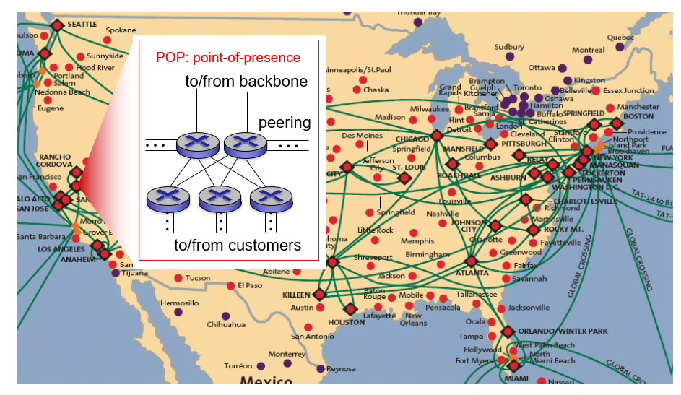
Internet Structure
www.corvit.com

Slide 23
What’s a protocol?
human protocols:
“what’s the time?”
“I have a question”
introductions
… specific messages sent
… specific actions taken when messages received, or other events
network protocols:
machines rather than humans
all communication activity in Internet governed by protocols
protocols define format, order of messages sent and received among network entities, and actions taken on message transmission, receipt
www.corvit.com

Slide 24



What’s a protocol?
a human protocol and a computer network protocol:
Hi
TCP connection
request
Hi
TCP connection
response
Got the
time?
Get http://www.awl.com/kurose-ross
2:00
<file>
time
Q: other human protocols?
www.corvit.com

Slide 25
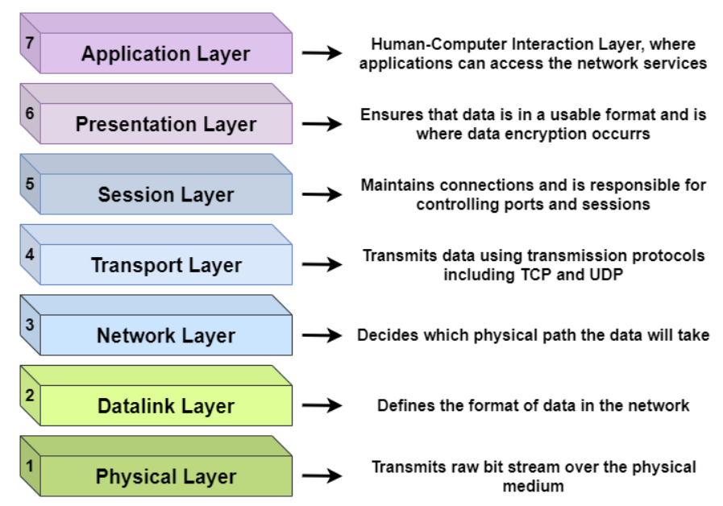
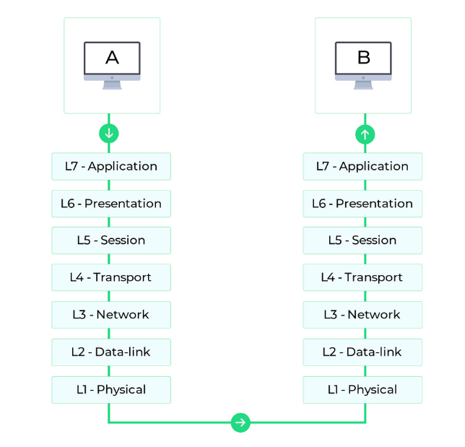
OSI Model
The Open Systems Interconnection (OSI) model describes seven layers that computer systems use to communicate over a network.
Each Layer represents a different category of networking functions
www.corvit.com

Slide 26
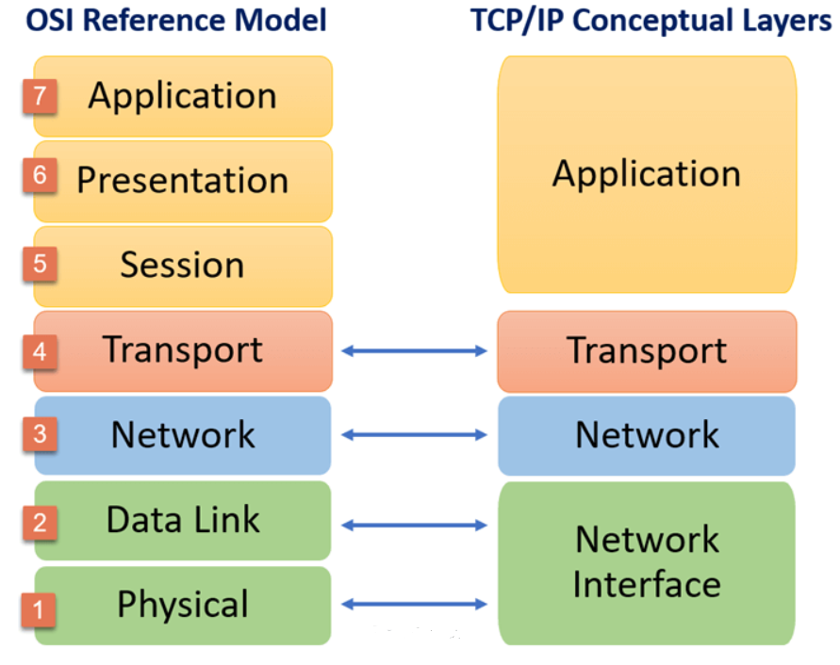
OSI vs TCP/IP Model
www.corvit.com

Slide 27
Encapsulation
source
message
M
application
transport
network
link
physical
segment
H_{t}
M
H_{t}
datagram
H_{n}
H_{n}
H_{t}
M
frame
H_{l}
H_{n}
H_{t}
M
link
physical
switch
destination
H_{n}
H_{t}
M
network
link
physical
M
application
transport
network
link
physical
H_{l}
H_{n}
H_{t}
M
H_{n}
H_{t}
M
H_{t}
M
H_{n}
H_{t}
M
H_{l}
H_{n}
H_{t}
M
router
www.corvit.com

Slide 28
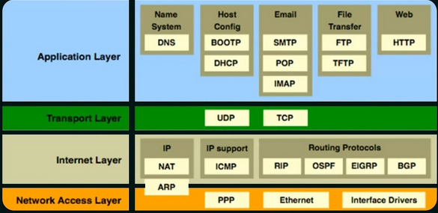
Network Protocols
application: supporting network applications
FTP, SMTP, HTTP, Telnet, SNMP.
transport: process-process data transfer
TCP, UDP
network: routing of datagrams from source to destination
IP, routing protocols
link: data transfer between neighboring network elements
Ethernet, 802.111 (WiFi), PPP, HDLC, Token Ring, Frame Relay, ATM.
physical: bits “on the wire”.
Fiber Optics, Coax, Microwave, Satellite.
www.corvit.com
Notes:
https://www.sce.carleton.ca/netmanage/dcommTutorials/scan05/scan05.html

Slide 29
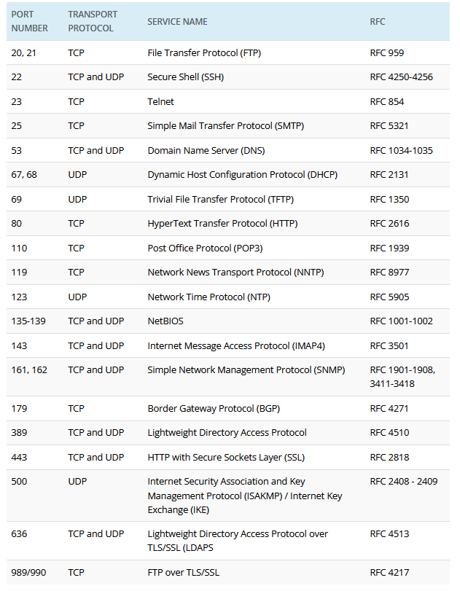
Network Protocols Port Numbers
www.corvit.com

Slide 30
Network security
field of network security:
how bad guys can attack computer networks
how we can defend networks against attacks
how to design architectures that are immune to attacks
Internet not originally designed with (much) security in mind
original vision: “a group of mutually trusting users attached to a transparent network” ☺
Internet protocol designers playing “catch-up”
security considerations in all layers!
www.corvit.com

Slide 31
Bad guys: put malware into hosts via Internet
malware can get in host from:
virus : self-replicating infection by receiving/executing object (e.g., e-mail attachment)
worm: self-replicating infection by passively receiving object that gets itself executed
spyware malware can record keystrokes, web sites visited, upload info to collection site
infected host can be enrolled in botnet, used for spam. DDoS attacks
www.corvit.com

Slide 32
Bad guys: attack server, network infrastructure
Denial of Service (DoS): attackers make resources (server, bandwidth) unavailable to legitimate traffic by overwhelming resource with bogus traffic
1. select target
2. break into hosts around the network (see botnet)
3. send packets to target from compromised hosts
target
www.corvit.com

Slide 33
Bad guys can sniff packets
packet “sniffing”:
broadcast media (shared Ethernet, wireless)
promiscuous network interface reads/records all packets (e.g., including passwords!) passing by
A
C
src:B dest:A payload
B
www.corvit.com

Slide 34
Bad guys can use fake addresses
IP spoofing: send packet with false source address
A
C
src:B dest:A payload
B
www.corvit.com

Slide 35
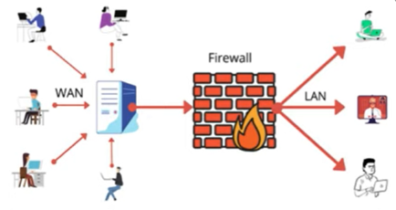
Firewall
In computing, a firewall is a network security system that monitors and controls incoming and outgoing network traffic based on predetermined security rules.
A firewall typically establishes a barrier between a trusted network and a n untrusted network such as the internet.
The primary goal of a firewall is to block malicious traffic requests and data packets while allowing legitimate traffic through.
www.corvit.com

Slide 36
Types of Firewall
Packet Filtering: It is a management program that can block network traffic IP protocol, an IP address and a port a number. This type of firewall is the most basic form of protection and is meant for smaller networks. A small amount of data is analyzed and distributed according to the filter’s standards.
Proxy Service: An early type of firewall device, a proxy firewall serves as the gateway from one network to another for a specific application. Proxy servers can provide additional functionality such as content caching and security by preventing direct connections from outside the network.
Stateful Inspection: A stateful inspection firewall allows or blocks traffic based on state, port and protocol. It monitors all activity from the opening of a connection until it is closed. Filtering decisions are made based on both administrator –defined rules as well as the context, which refers to using information from previous connections and packets belonging to the same connection.
www.corvit.com

Slide 37
Types of Firewall
Unified Threat Management (UTM) Firewall: The functions of a stateful inspection firewall with intrusion prevention and antivirus. It may also include additional services and often cloud management. UTMs focus on simplicity and ease of use.
Next Generation Firewall (NGFW): Firewalls have evolved beyond simple packet filtering and stateful inspection. Most companies are deploying NGFW to block modern threat such as advanced malware and application-layer attacks. A NGFW includes standard firewall capabilities like stateful inspection, integrated intrusion prevention, application awareness and control to see and block risky apps, upgrade paths to include future information feeds and techniques to address evolving security threats.
www.corvit.com

Slide 38
Web Application Firewall
A WAF or web application firewall helps protect web applications by filtering and monitoring HTTP traffic between a web application and the Internet.
It typically protects web applications from attacks such as cross-site forgery, cross-site-scripting (XSS), file inclusion, and SQL injection, among others.
A WAF is a protocol layer 7 defense (in the OSI model), and is not designed to defend against all types of attacks. This method of attack mitigation is usually part of a suite of tools which together create a holistic defense against a range of attack vectors.
By deploying a WAF in front of a web application, a shield is placed between the web application and the Internet. While a proxy server protects a client machine’s identity by using an intermediary, a WAF is a type of reverse-proxy, protecting the server from exposure by having clients pass through the WAF before reaching the server.
A WAF operates through a set of rules often called policies.
These policies aim to protect against vulnerabilities in the application by filtering out malicious traffic.
The value of a WAF comes in part from the speed and ease with which policy modification can be implemented, allowing for faster response to varying attack vectors; during a DDoS attack, rate limiting can be quickly implemented by modifying WAF policies.
www.corvit.com

Slide 39
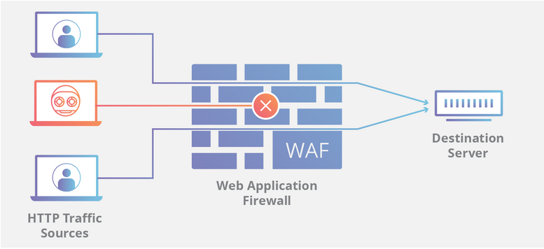
Web Application Firewall
www.corvit.com

